Slide 1

Flipkart Application
Presented By:
Aman Asthana(6603)
Munit Yadav(6615)

Slide 2
Problem Statement
E-commerce provides an easy way to sell products to a large customer base. However, there is a lot of competition among multiple e-commerce sites. When users land on an e-commerce site, they expect to find what they are looking for quickly and easily.
The purpose of any e-commerce website is to help customers narrow down their broad ideas and enable them to finalize the products they want to purchase.
The challenge is also that each category will have a different set of facets to be displayed. For example, searching for books should display their format, as in paperpack or hardcover, author name, book series, language, and other facets related to books.

Slide 3
Our Objectives
Reduce management costs.
Developing business relations.
Providing a unique customer experience.
Increasing the number of loyal customers.
Boosting the efficiency of services.
Developing relevant target.
Making responsive ecommerce website.
Increasing sales.

Slide 4
Introduction
It is true that technology has become an essential tool for online marketing nowadays. However, there are numerous small shops and grocery stores with mostly offline business model in Vietnam recently. With this commerce model, it will bring a lot of bad experiences for both buyers and sellers
For instance, the seller has the product want to offer but the buyer may not know it, or the buyer may urgently need to purchase something, but the store is out of stock. Moreover, online shopping helps customers to choose a wide range of products, prices and they can compare them to each other easily.
In order to make a website that can acquire the needs of both customers and retailers, MERN (MongoDB, Angular framework, React JS , Node JS platform) is one of the powerful stacks that can help us to develop an e-commerce web application.

Slide 5
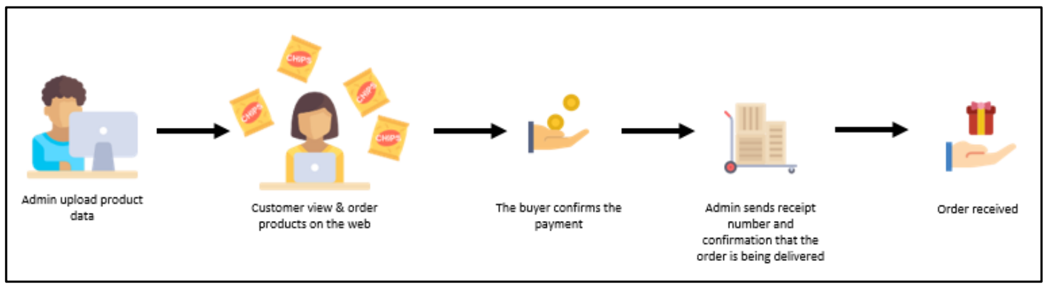
Workflow Diagram

Slide 6
Why Angular?
Two-Way Data Binding
Angular has two-way data binding, which automatically updates the view when data in the model changes and vice versa. Angular also has two-way data binding, which automatically updates the view when data in the model changes and vice versa.
Fast Loading
Angular has fast and efficient, making it a great choice for high website traffic. And makes it a great choice for public-facing websites. In addition, angular performance optimizations make it ideal for high-traffic websites.
Using Directives
This is the most important part of Angular. Directives are like an extension to HTML, making it easier for you to build your web pages and applications with less code.

Slide 7
Conti..
Templates
Angular also has templates that make it easier to build your web applications. These include HTML, JavaScript, and CSS that are pre-compiled into the framework.
Client-Side Solution
Angular is a client-side solution, making it a great choice for developing web applications. This means that all the code runs on the user's computer instead of on the server.
TypeScript
Angular applications are built using TypeScript language, a superscript for JavaScript, which ensures higher security as it supports types (primitives and interfaces). It helps catch and eliminate errors early in the process while writing the code or performing maintenance tasks.

Slide 8
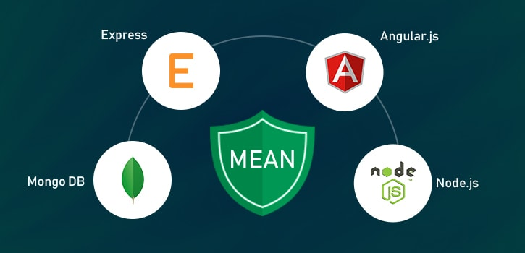
Technology Stack

Slide 9
Software Requirements
Windows –10
Languages : MEAN & MERN
Front end : HTML , CSS , BOOTSTRAP , Angular
Back end : Node JS
Web Server : Localhost
Database : MongoDB

Slide 10
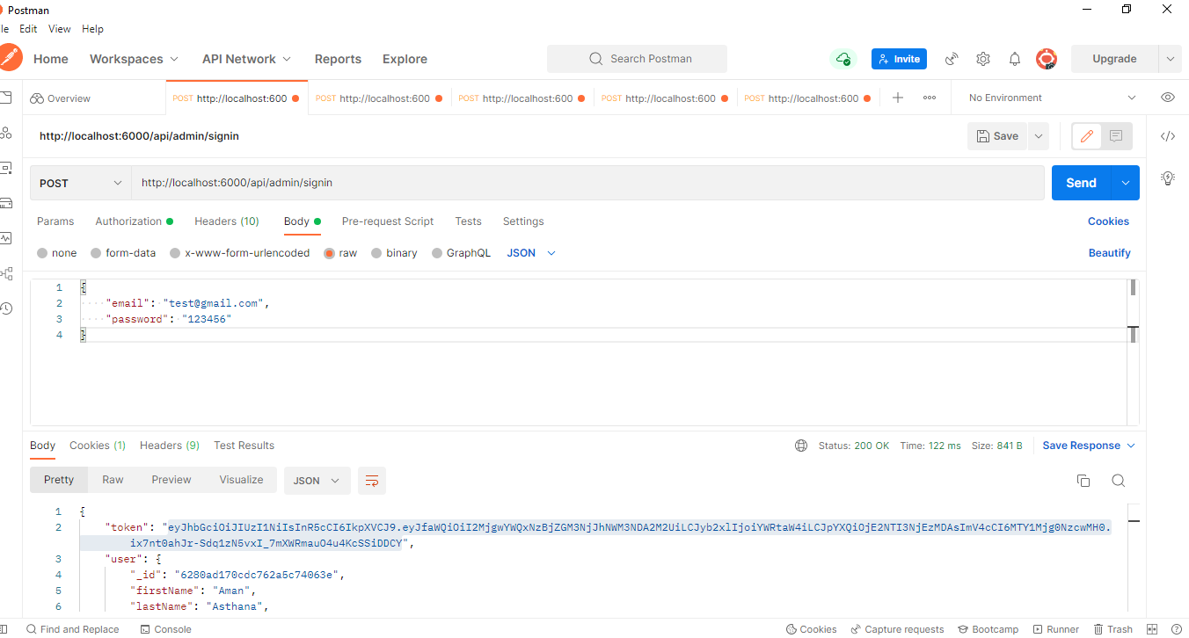
Postman Documentation

Slide 11
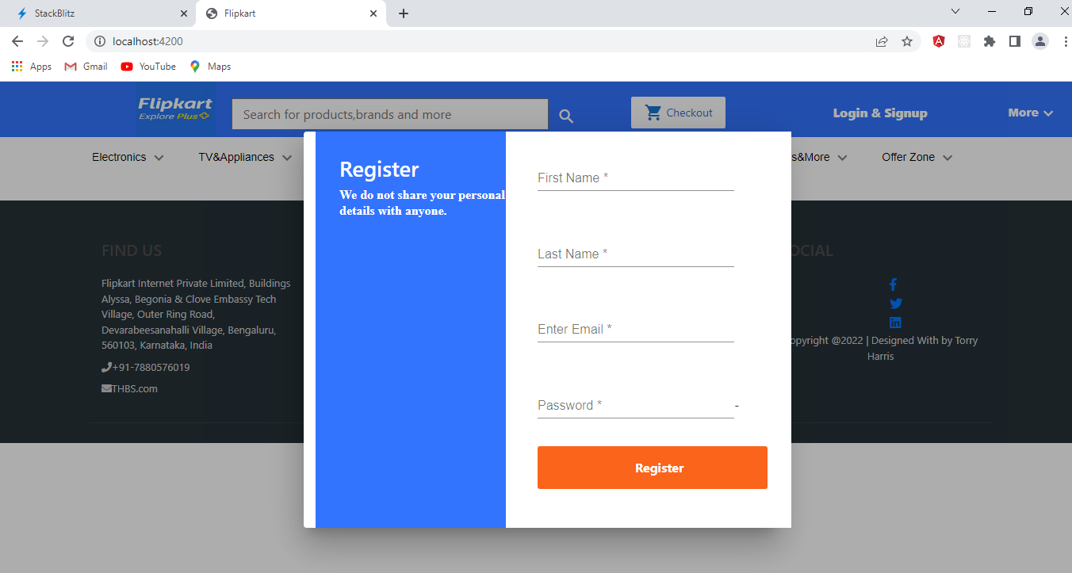
Registration Page

Slide 12
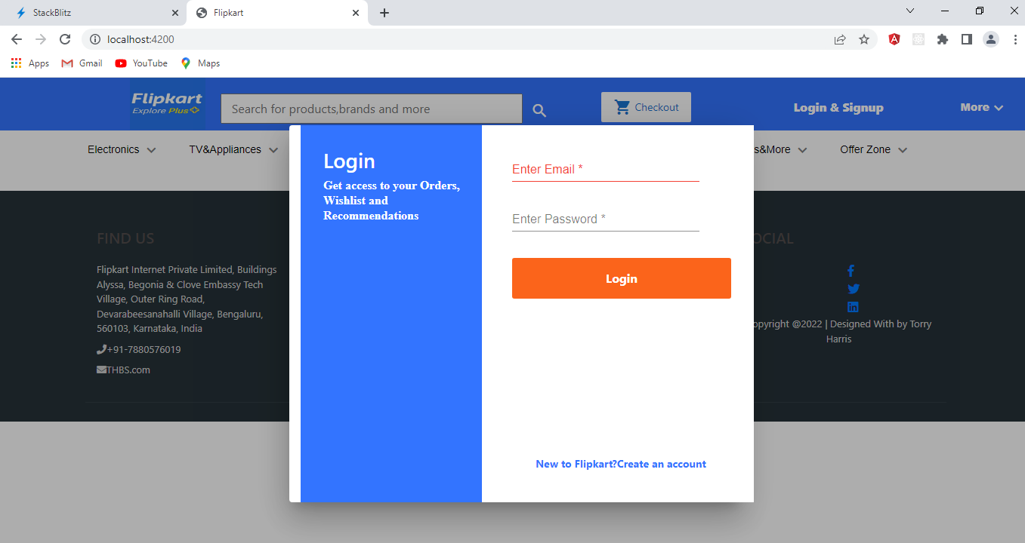
Login Page

Slide 13
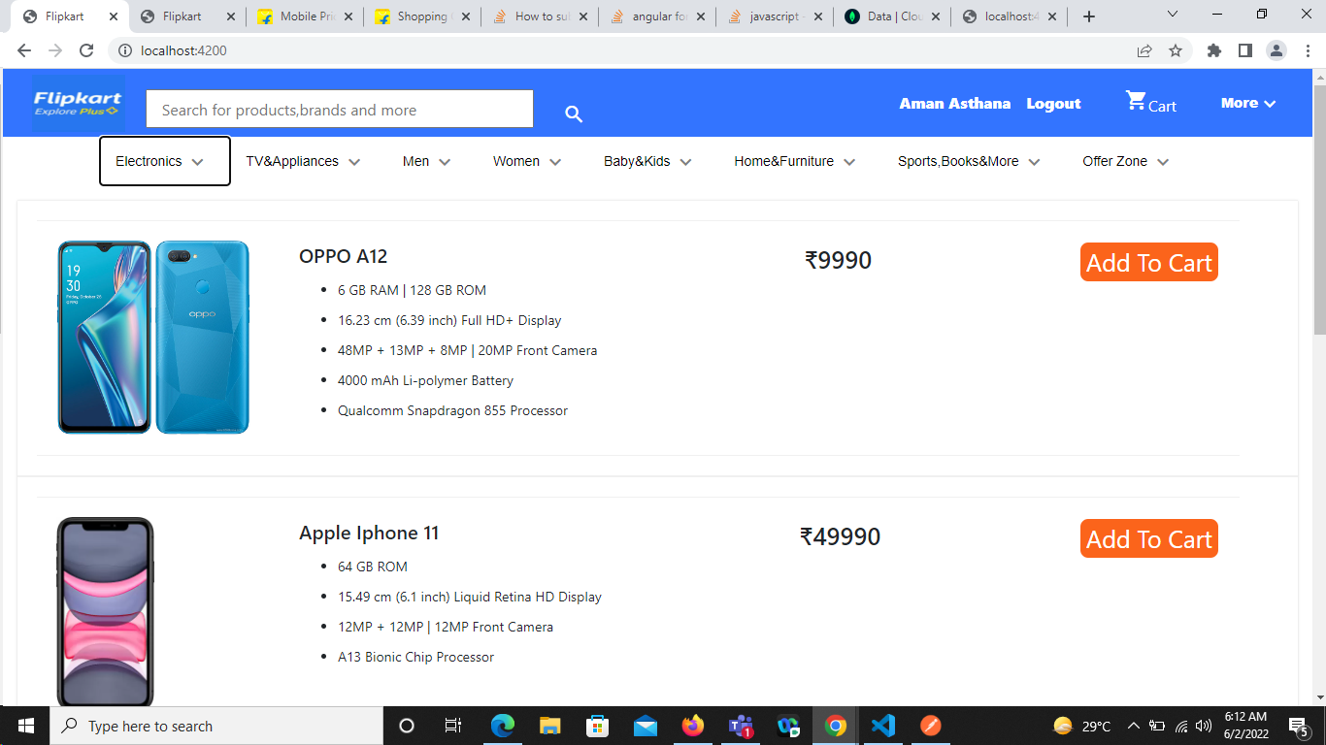
Home Page

Slide 14
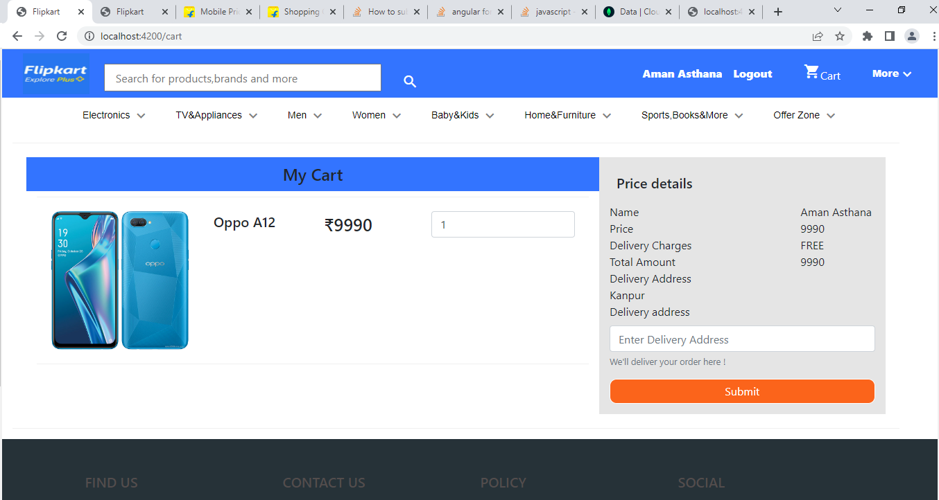
Order Now

Slide 15
Thank You

